Slide 1
Microservices
Nick Escalona @ Revature 5/20/2020

Slide 2
What problem are we solving?
Applications are often built as a “monolith” - all the code, except maybe for the DB and the UI, is compiled together and deployed together. What’s the problem?
One small change = build and deploy the whole thing
Hard to keep the code well organized with strong abstractions
If one part of the app is a bottleneck, we have to scale the whole app

Slide 3
Principles of MSA
Have many services - each service implements one business capability
Services...
Are developed independently
Are deployed independently
Are scaled independently
Control their own logic and their own data
Products not projects
Smart endpoints and dumb pipes
CI/CD

Slide 4
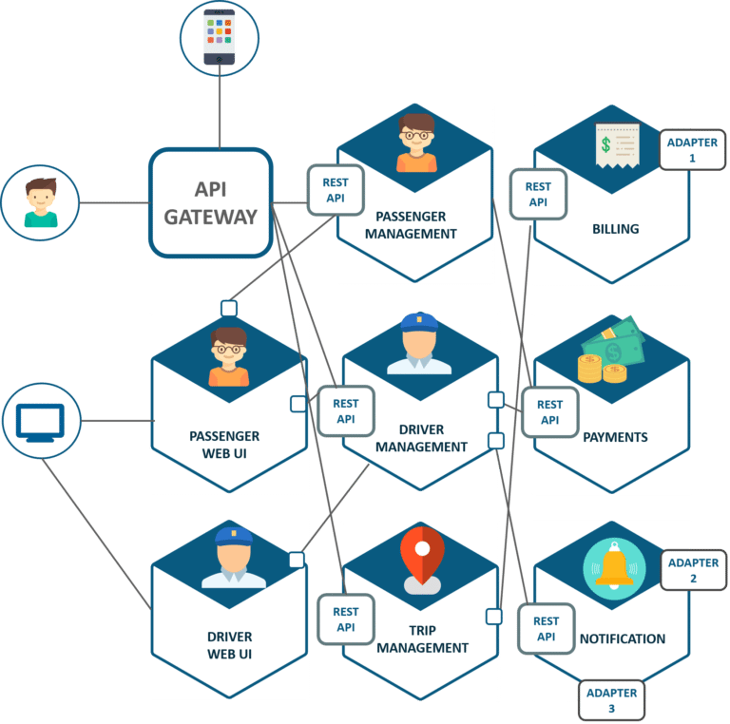

Slide 5
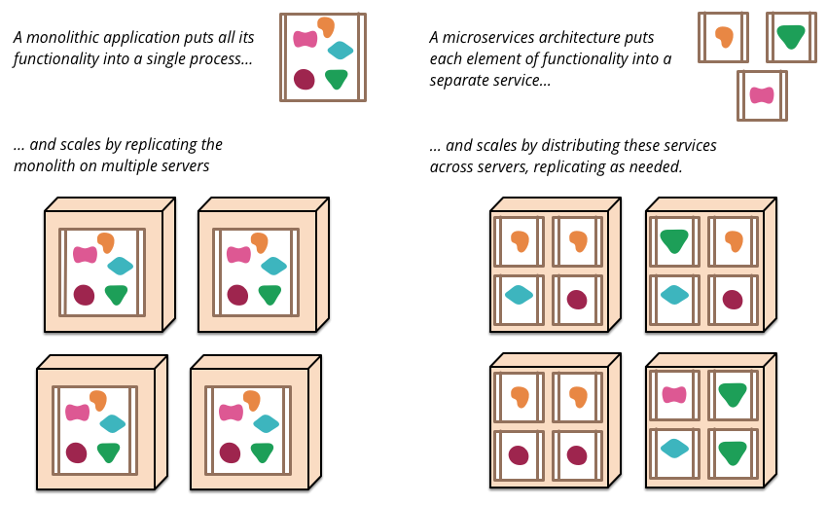

Slide 6
Advantages
Long-term flexibility
Scaling of actual function that needs more resources = cost savings
Works well with Agile
Loose coupling is more enforced by the architecture

Slide 7
Why not one database?
Centralized database is a performance bottleneck
Bloated tables with dozens or 100+ columns
Would you use the same map for a hike, for a road trip, and for learning geography?
Each service stores only the data it needs
Free to use the data tech suiting its needs
Free to format the data as it needs
Data sovereignty

Slide 8
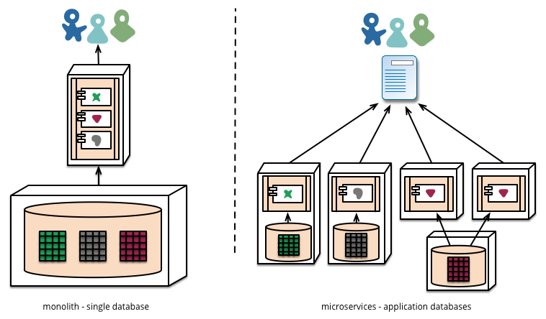

Slide 9
Downsides of data sovereignty
Lose full power of SQL
Lose easy ACID transactions across services
We can’t lock down a service until transaction is finished: too slow
We don’t want to in the first place: services are independent
Eventual consistency

Slide 10
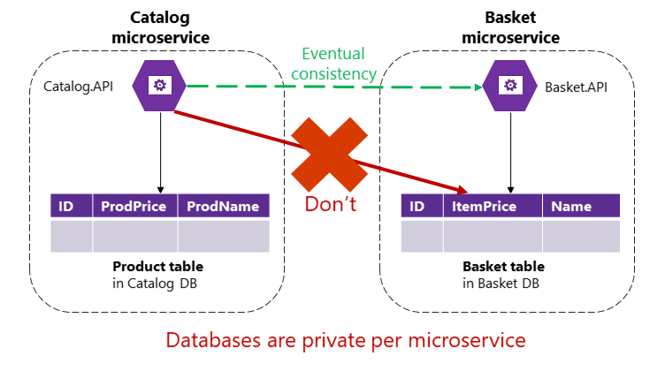

Slide 11
Special Concerns in MSA
Where to draw service boundaries?
Different language for the “same thing” is a clue
E.g. account, user, profile, customer, buyer
Domain-driven design (DDD) fits well
How to combine data spread out across all these services?
API gateways
Danger - coupling services, single point of failure
Too much of this can be a sign of bad service boundaries

Slide 12
Special Concerns in MSA
Eventual consistency
Services should be independent, autonomous
Lightweight message queue / event bus instead of HTTP
One service publishes event, many can subscribe

Slide 13
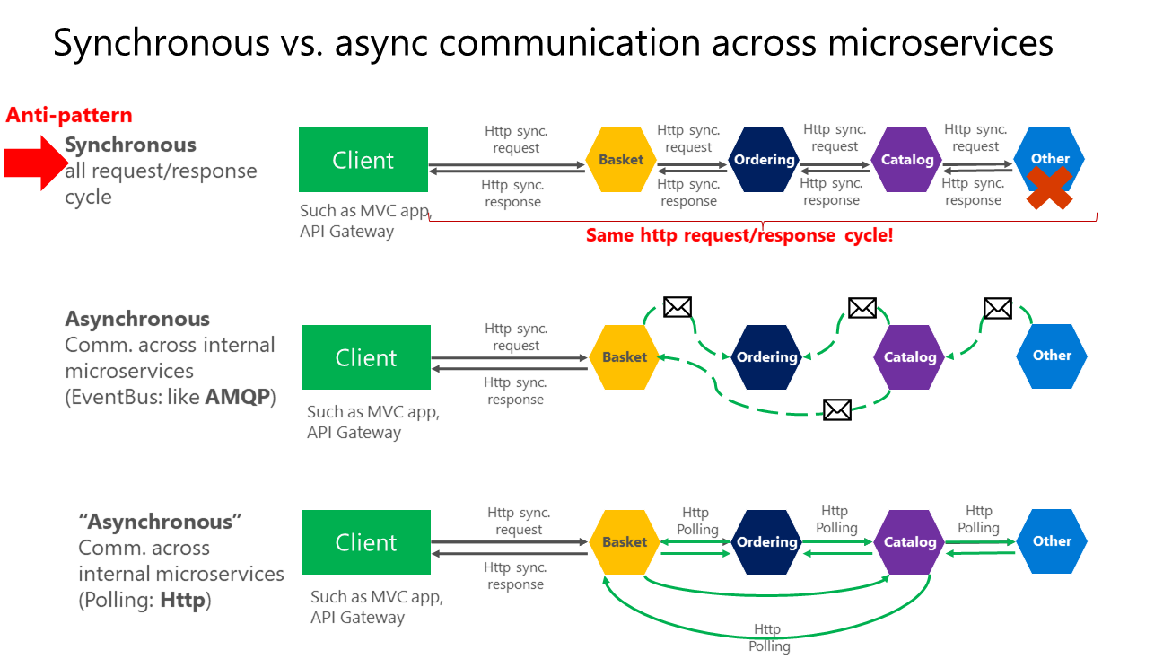

Slide 14
Special Concerns in MSA
Service failure resiliency
Monitoring of service health in production
Scalability of services and their resources
Security in auth and service communication
Container orchestration can help with those!

Slide 15
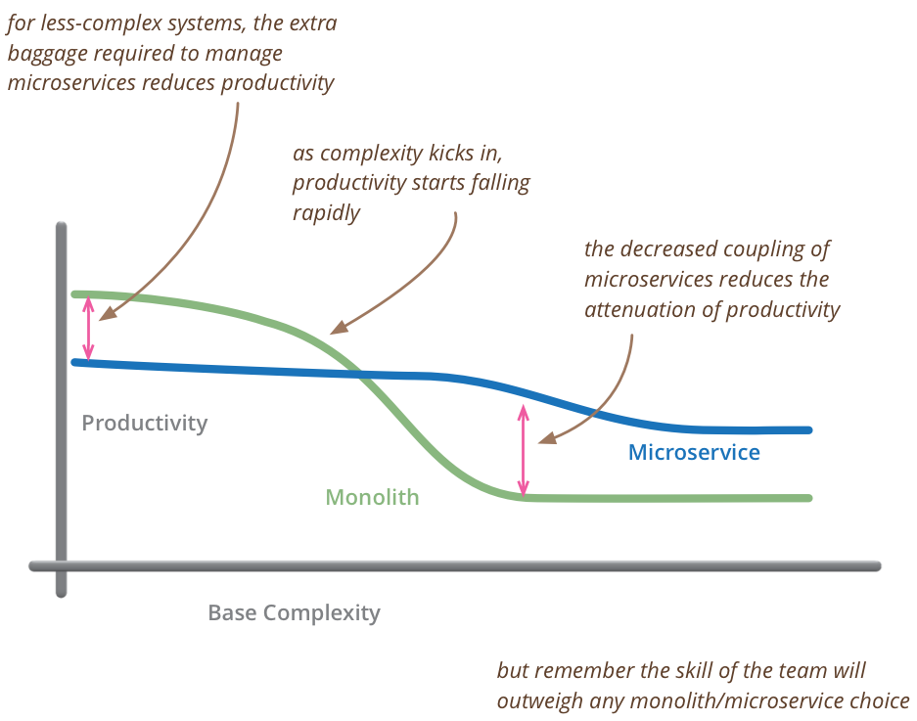
When not to use MSA

Slide 16
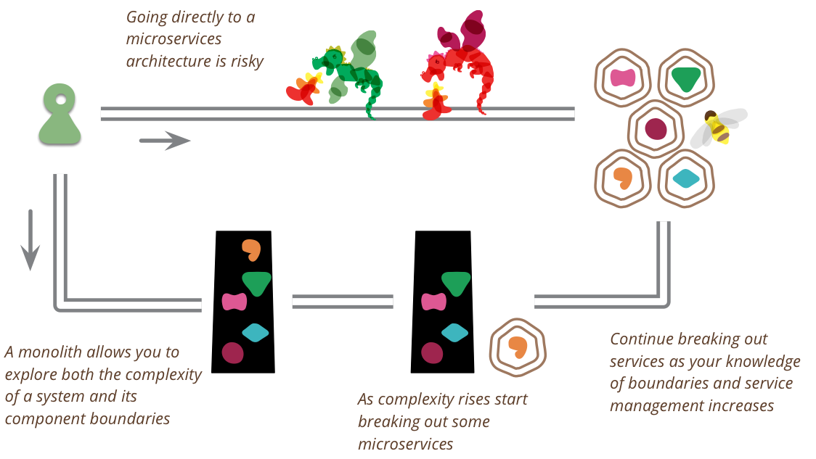
Monolith + MSA?
Some say, start with a monolith and evolve it to MSA if and when needed
Pros:
That’s what most MSA success stories did
Do we really know where to draw all the service boundaries before we have an MVP?

Slide 17
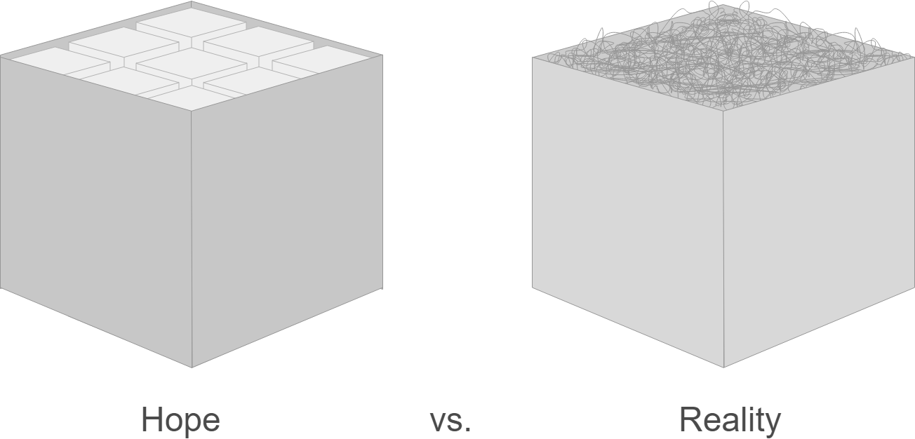
Monolith + MSA?
Some say, start with a monolith and evolve it to MSA if and when needed
Cons:
The monolith’s parts will inevitably be more tightly coupled to each other
Good module separation in a monolith might not be the same as good service boundaries

Slide 18
Things that go well with MSA
Agile
DevOps, CI/CD
Containers/Docker
Orchestration/Kubernetes
Automated testing
REST

Slide 19
MSA pioneers
Netflix
Open source tools
Simian Army
High value on async communication between services
Amazon
High value on devs owning product through production; devs = ops

Slide 20
Resources
https://martinfowler.com/microservices/
https://docs.microsoft.com/en-us/dotnet/architecture/microservices/

